Slide 1


Marketing strategies of bank - Analysis

Slide 2

Introduction
Subscription of term deposits is crucial for banks.
It is an inexpensive source of funding
Banks earn profits by lending money to their customer at higher rates than the cost of funding
A term deposit is a type of deposit account held at a financial institution where money is locked up for a set period.
They offer higher interest rate than the traditional savings account.
Higher subscription to term loans is vital for banks to increase lending capacity.

Slide 3
Business problem
Improve
Improve marketing strategies to attract new term deposits
Expand
Expand reach to the target audience
Understand
Understand impact of different factors on customer’s decision
Retain
Retain existing customers by analyzing the competition

Slide 4
Data - Attributes
The dataset has been retrieved from Kaggle and represents the results of marketing campaigns and the time since the last contact with customer.
Age
Job
Marital status
Education
Defaulter
Housing loan
Loan
Contact
Day
Month
Duration
Campaign
Pdays
Previous
Poutcome
Deposit

Slide 5
Stakeholders
Customers
Employees
Shareholders and investors
Government

Slide 6
Exploratory Data analysis
Box plot
Bar charts
Scatter plots
Heat maps
Ribbon chart
Bubble chart

Slide 7
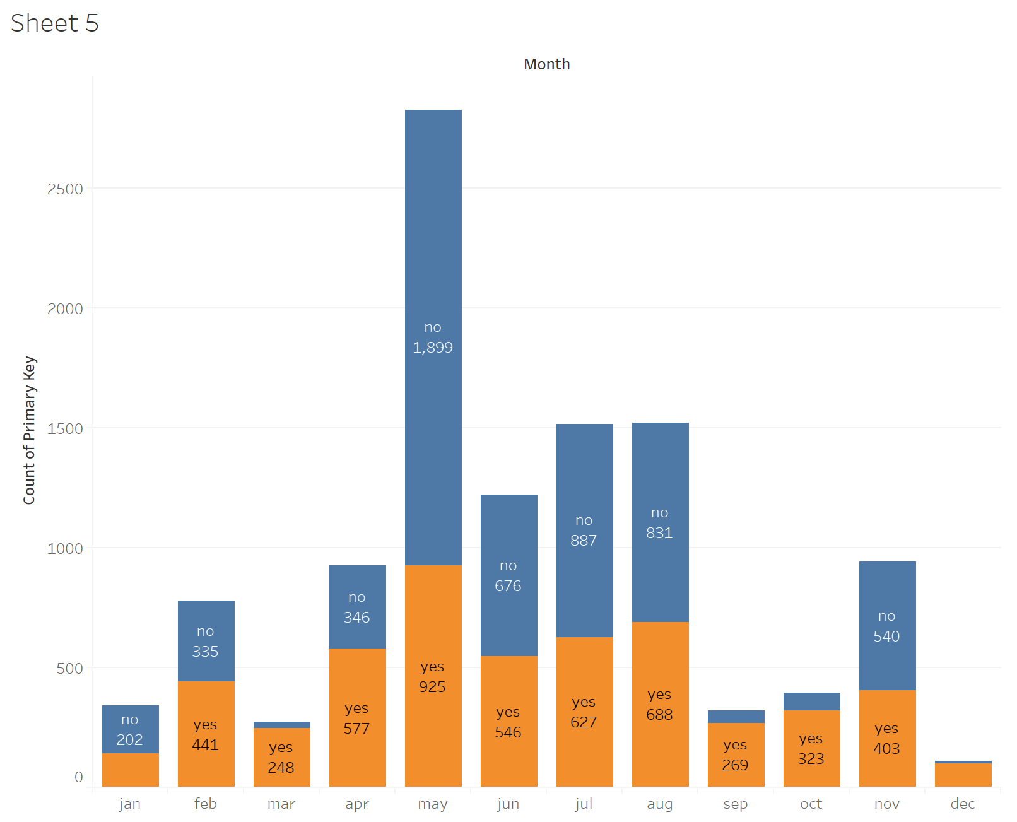
Exploratory data analysis
Campaign calls and responses by month
Notes:
Marketing calls were highest in the month of May, however the conversion rate was low. The conversion rate was highest in the months of July, August and November(more than 50%).

Slide 8
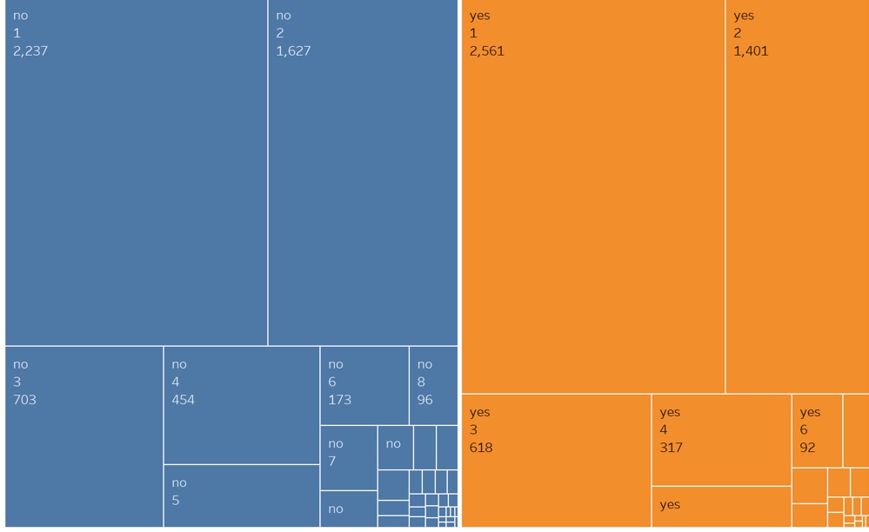
Exploratory data analysis
Number of calls and conversions
Notes:
Conversion rate was highest when the number of calls was between 1-3

Slide 9
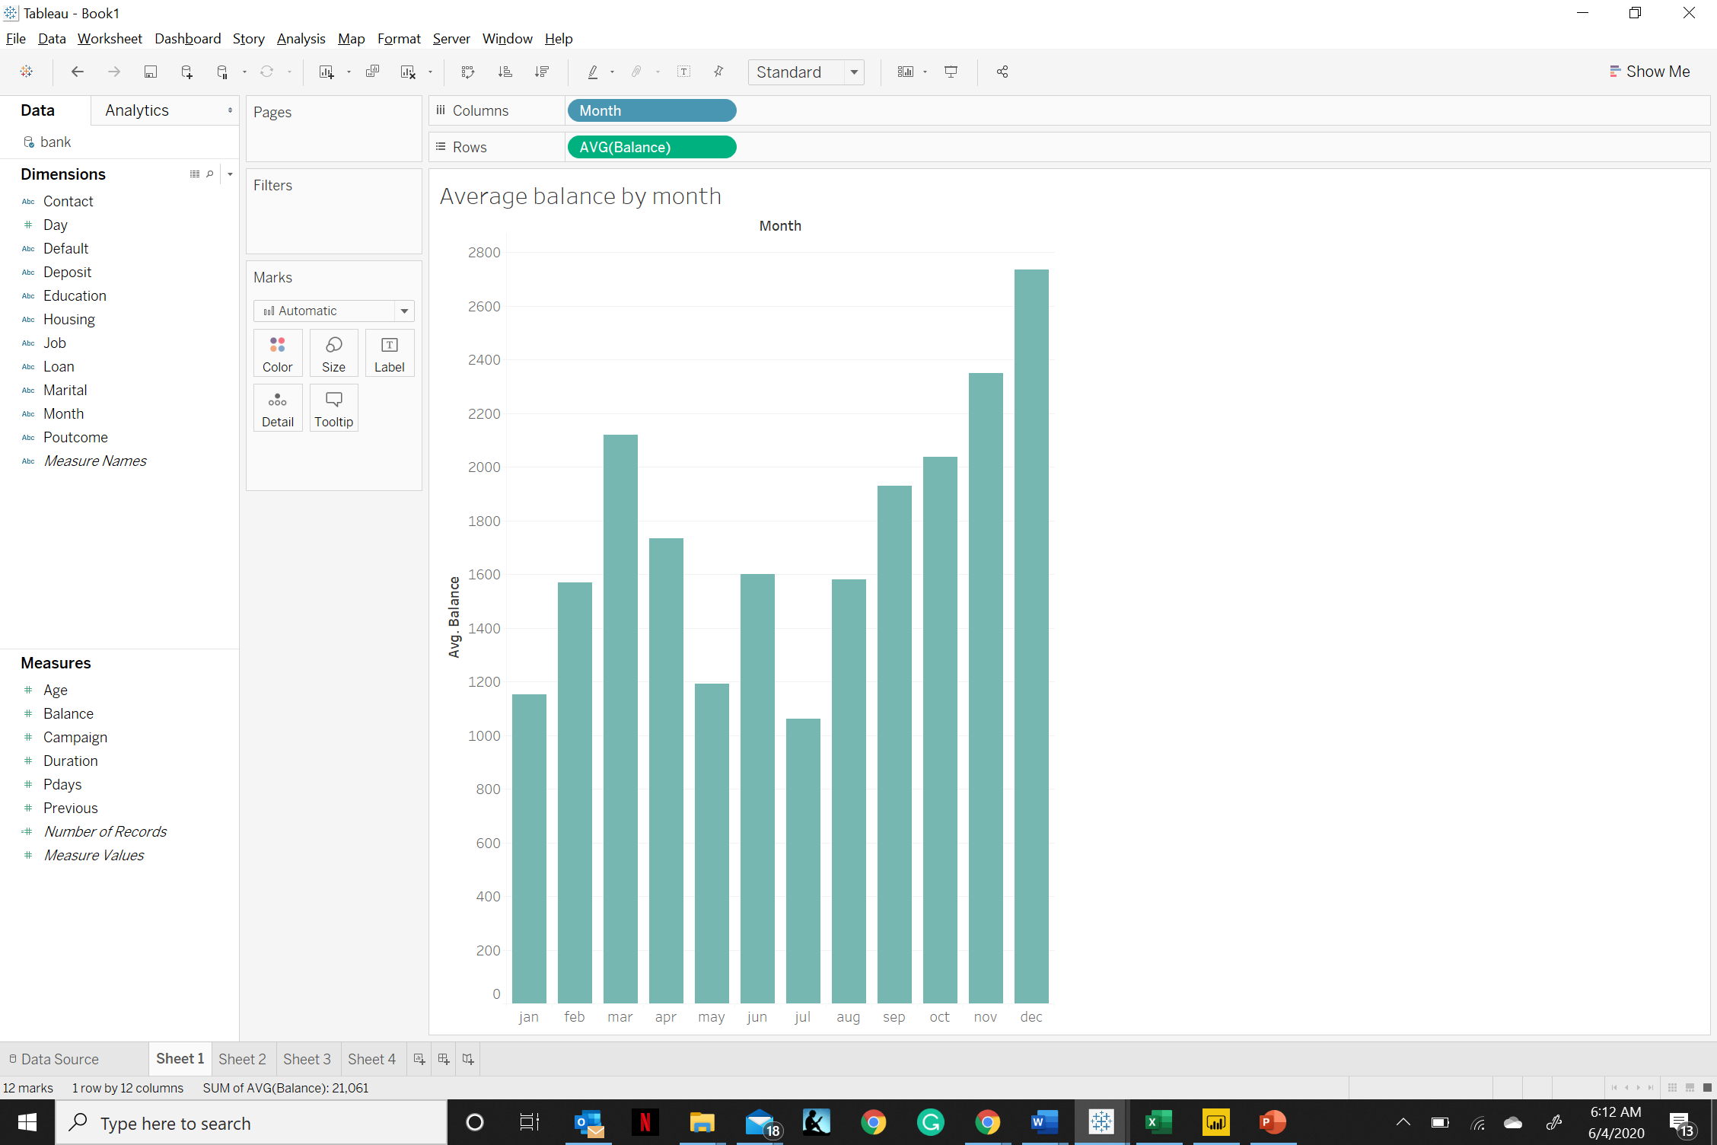
Exploratory data analysis
Balance by Month
Notes:
Customers had highest account balances in the month of November and December followed by March

Slide 10
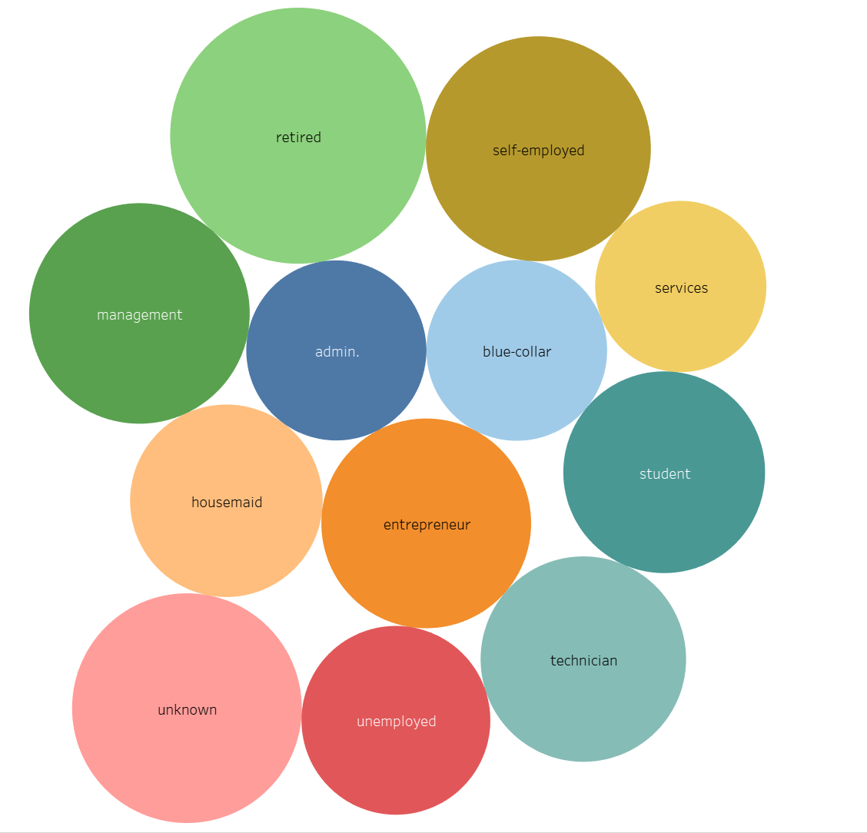
Exploratory data analysis
Account balance by job
Notes:
Retired people had highest average balance followed by self employed.

Slide 11
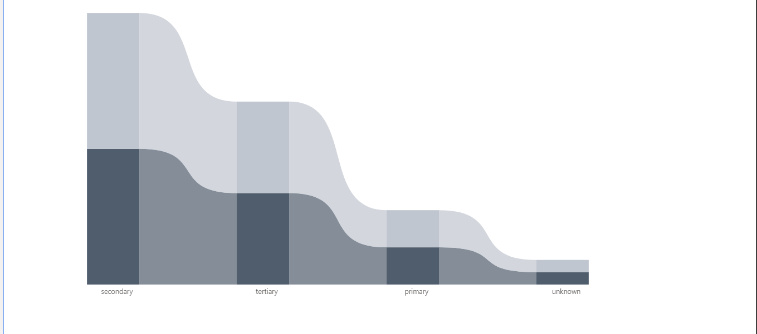
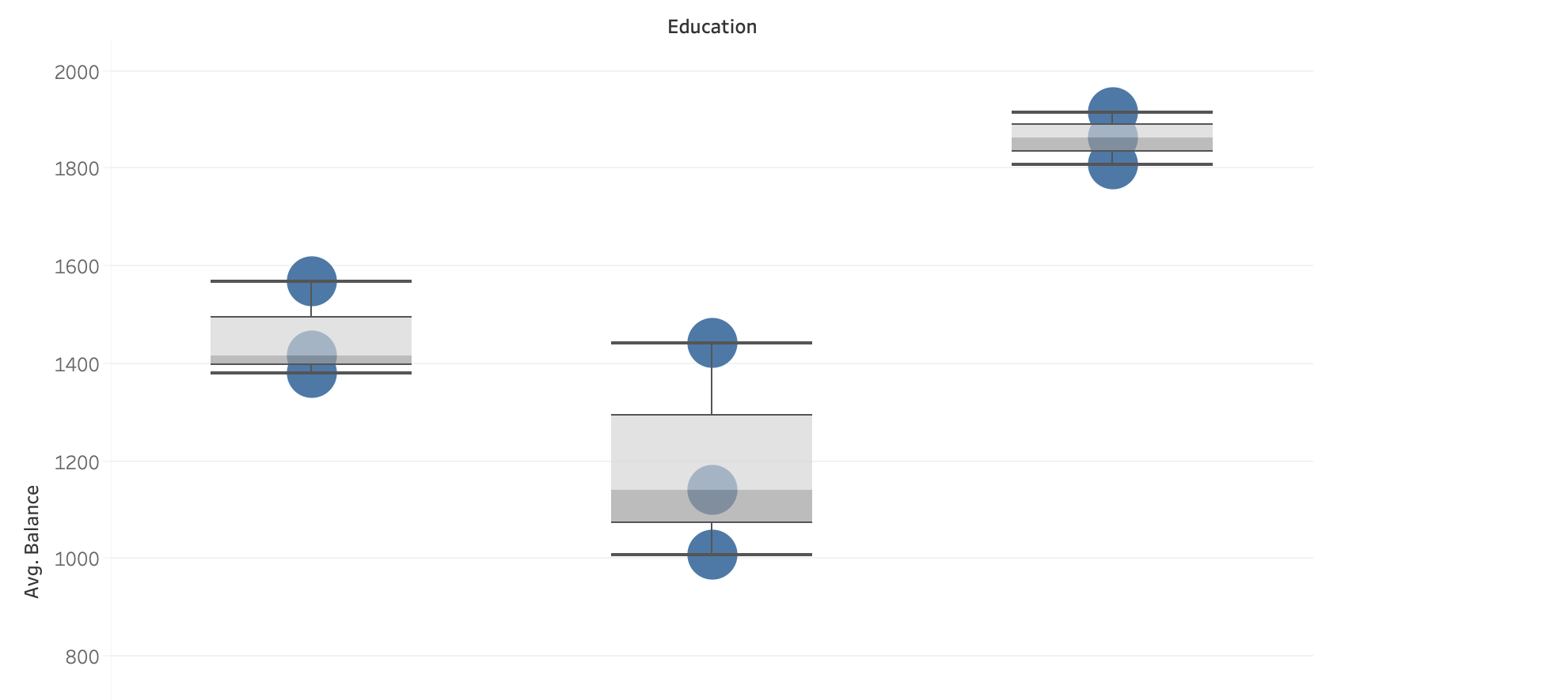
Exploratory data analysis
Deposit accounts by education
Education and average balance
Notes:
Secondary education people had higher number of deposit accounts and tertiary education segment had highest average account balance.

Slide 12
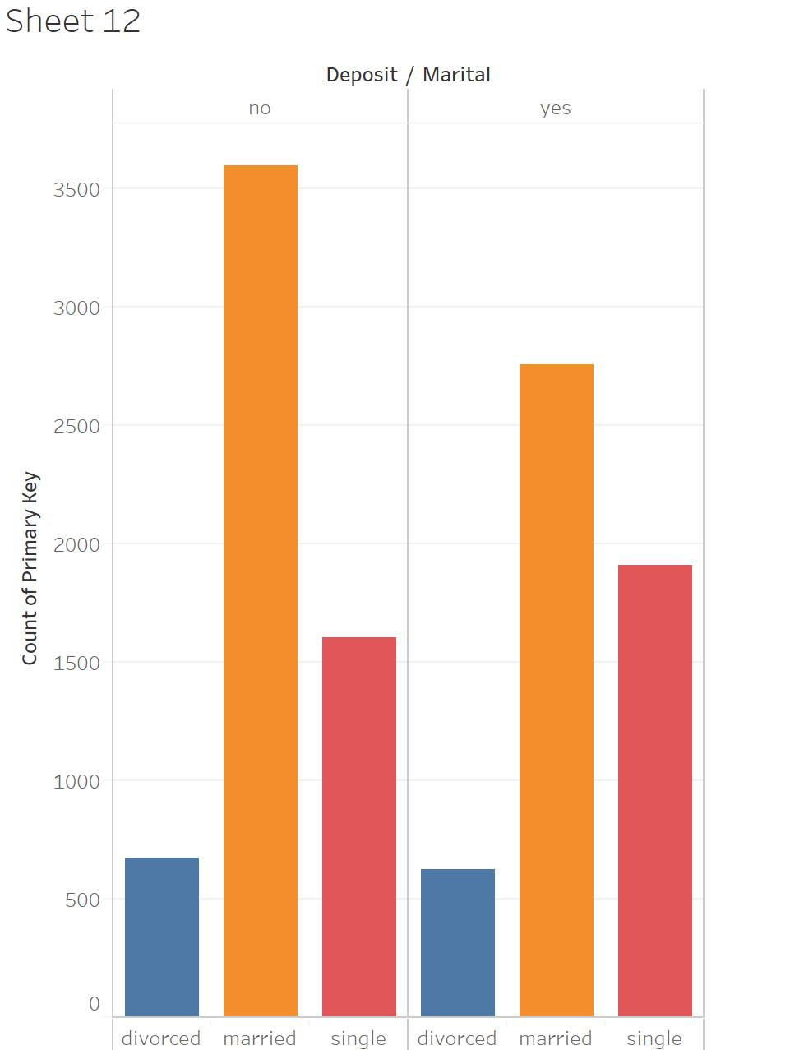
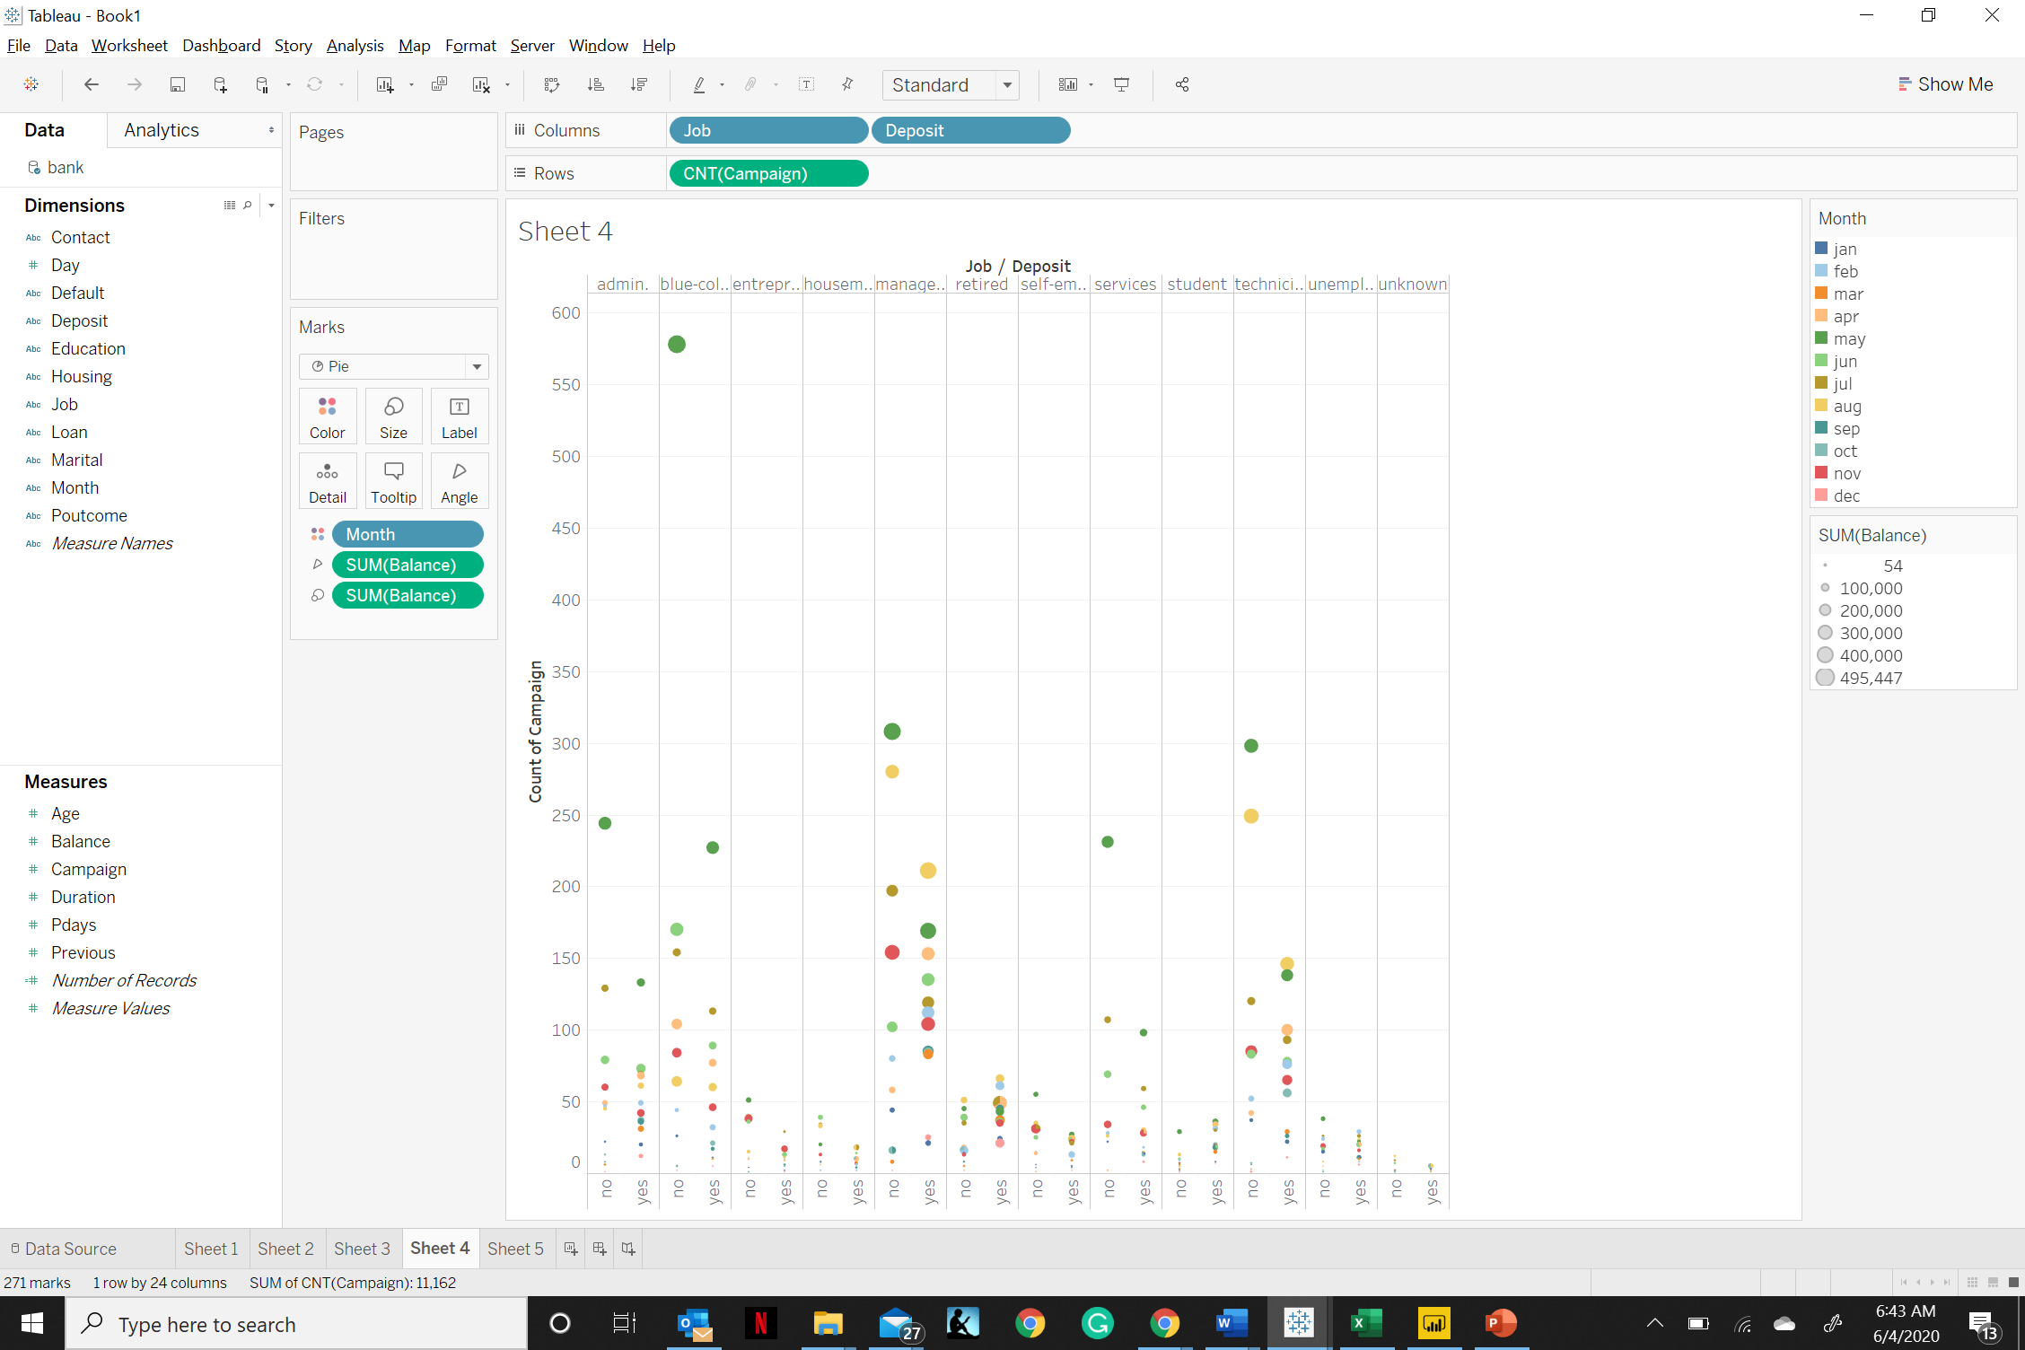
Exploratory data analysis
Deposit accounts by marital status
Deposit accounts by job
Notes:
Married people had higher number of deposit accounts – first graph
Second-Management role had higher number of deposit accounts

Slide 13
Results of Exploratory data analysis
People in the age group between 30-33 had highest balances followed by self-employed and the management level employees.
The conversion rate to term deposits was highest when the number of campaign calls were between 1-3.
It was interesting to see that the balances in the month of December and November were highest followed by the month of March.
Most number of customers that had a loan account were married.
Married people had the higher number of term deposit accounts in comparison with divorced and single people.
People working at the management level had highest average account balances.
People with tertiary education were higher in number in the management roles and had more loan accounts in comparison with other job categories.
People with secondary education held the highest number of deposit accounts.

Slide 14
Constraints to EDA
This analysis is based on the dataset which has fewer instances of people aged between 80-85 and a greater number of instances of people between 30-35.
About 60% of the job roles in the dataset belonged to just three categories, namely admin, blue collar and technician.
The number of people holding and not holding a housing loan account was almost the same.

Slide 15
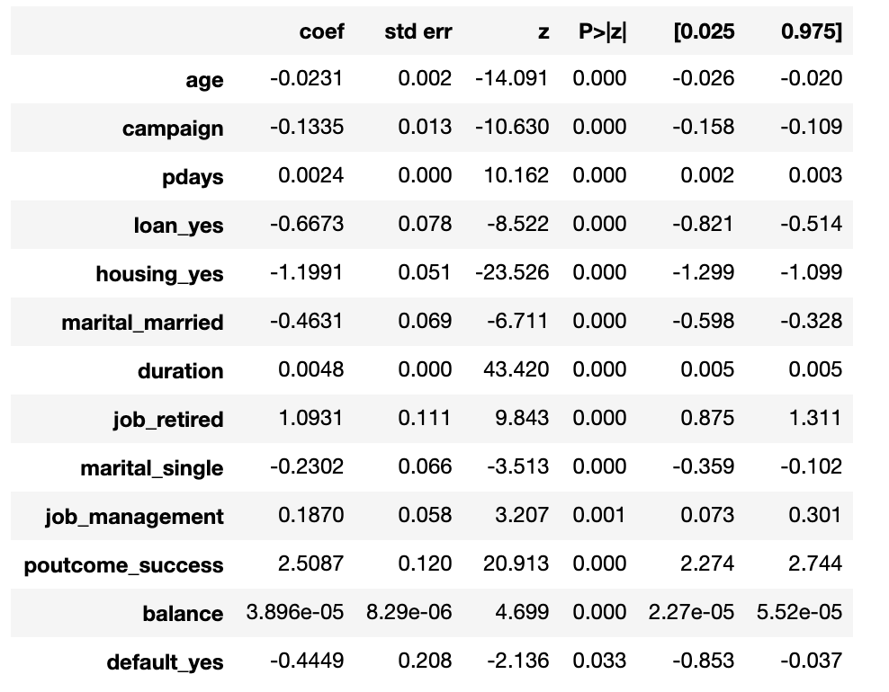
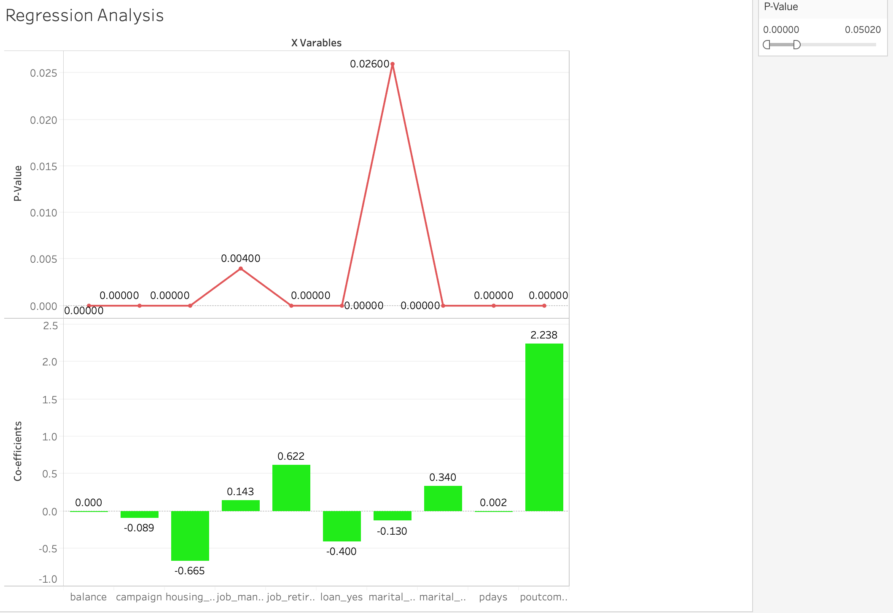
Logistic Regression
Logistic Regression Analysis to determine the dependency of Y categorical variable (opened term deposit or not) on the various x variables.
Campaign, pdays (no of days since last contacted), loan, housing, balance, retired, management, marital status, duration, education, outcome of the previous marketing campaign is statistically significant.
From the exploratory data analysis and regression analysis we conclude that marketing campaigns, jobs(management, retired),loans, balance of the individual are the most important and distinguishing features
Example – If a person has a loan, the probability of opening a term deposit decreases by 0.400 unit.

Slide 16
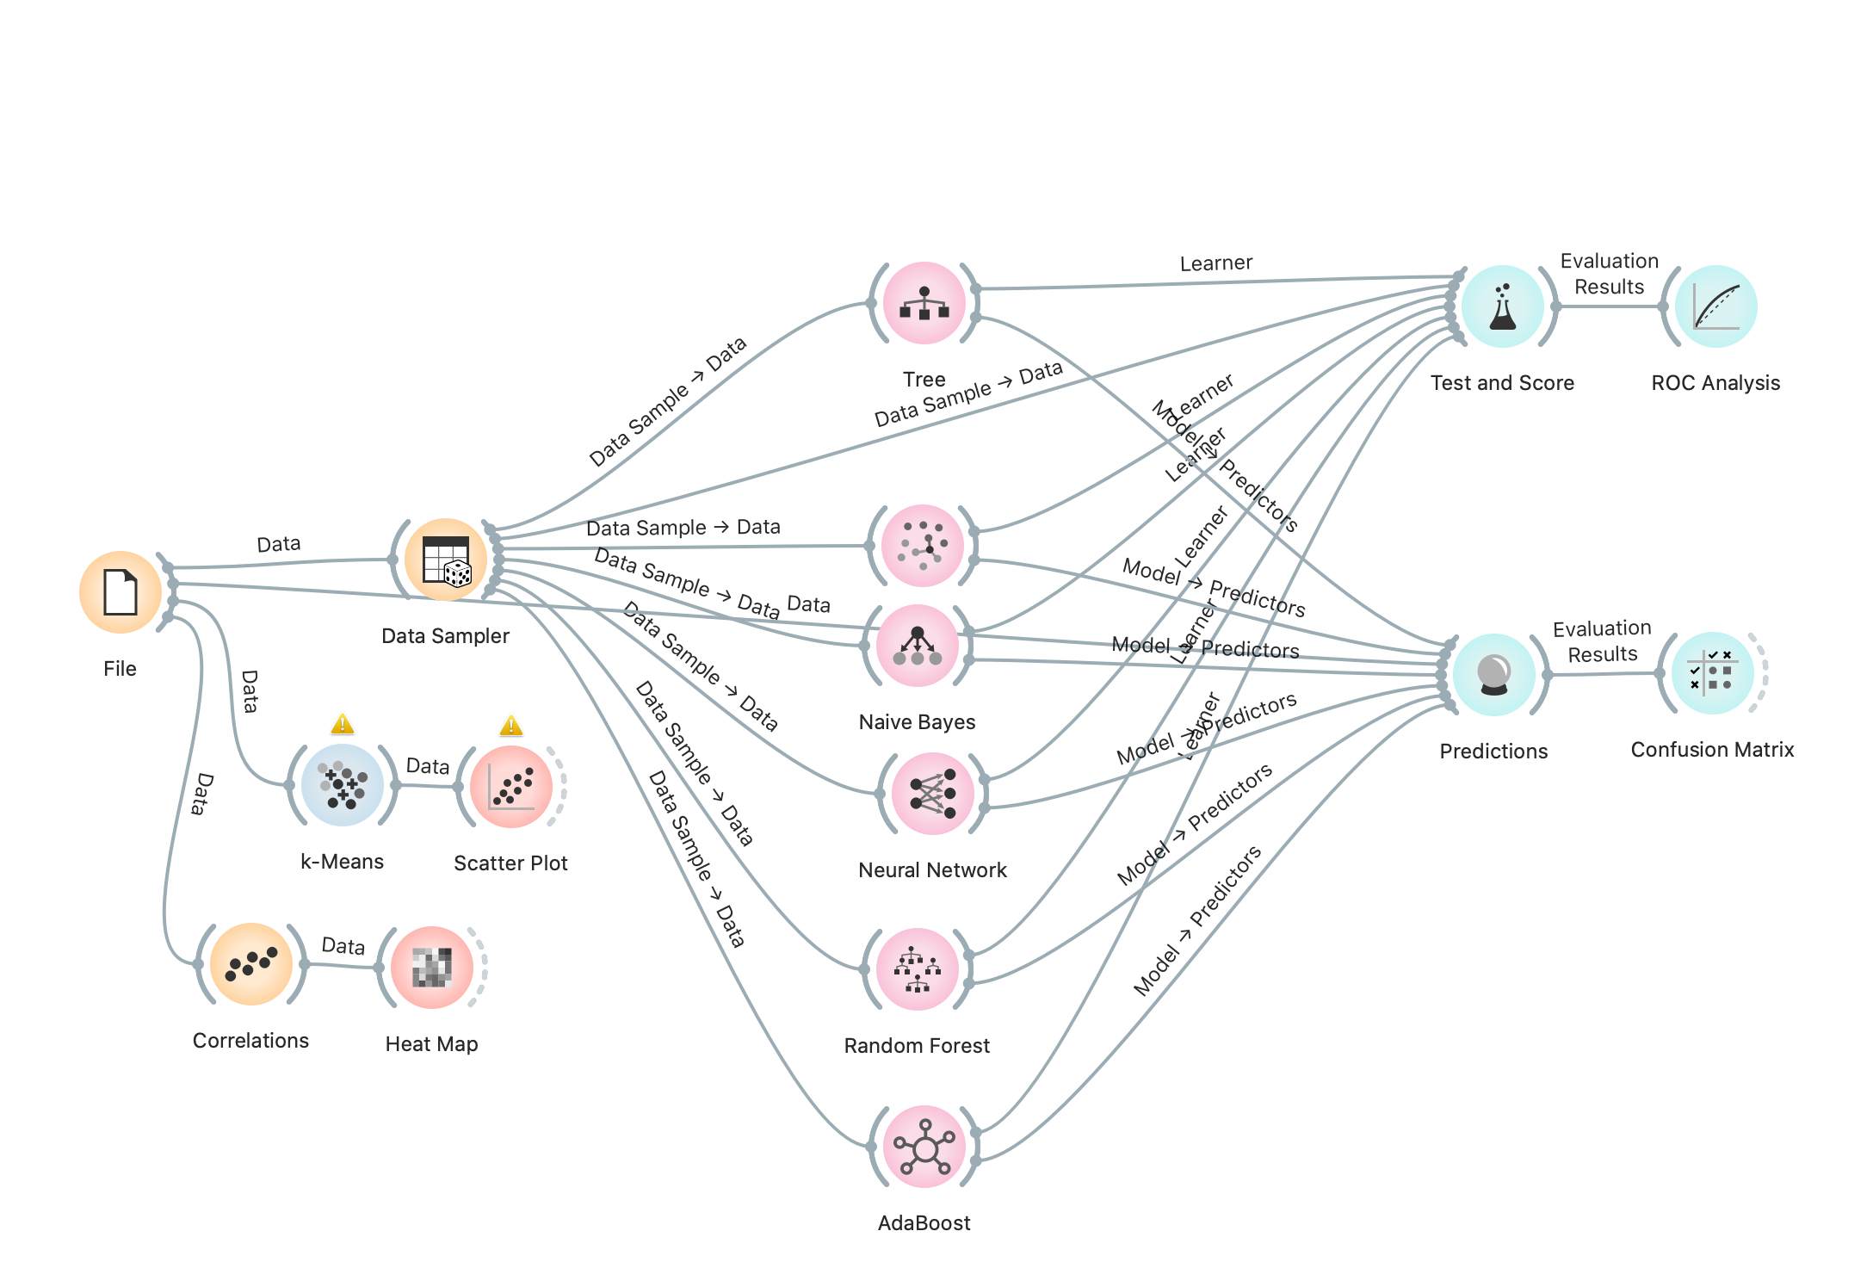
Classification Model
Orange is used as the data mining tool.
Data sampling technique – Random (70:30)
70- Training Data set, 30 –Test Data Set
Cross-Validation with 10 folds.(to avoid over-fitting of the data).
This algorithm will iterate through all the training and test sets and the main purpose of this is to grab the overall pattern of the data.

Slide 17
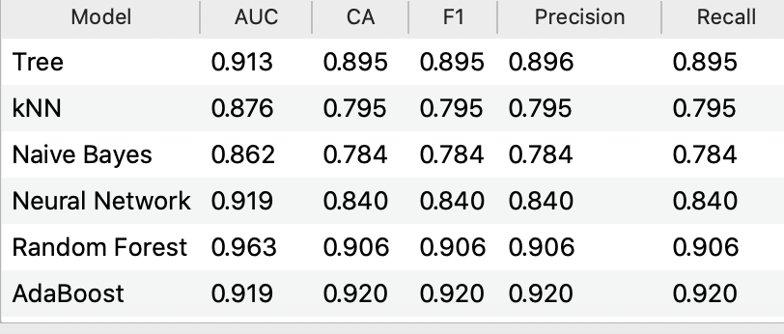
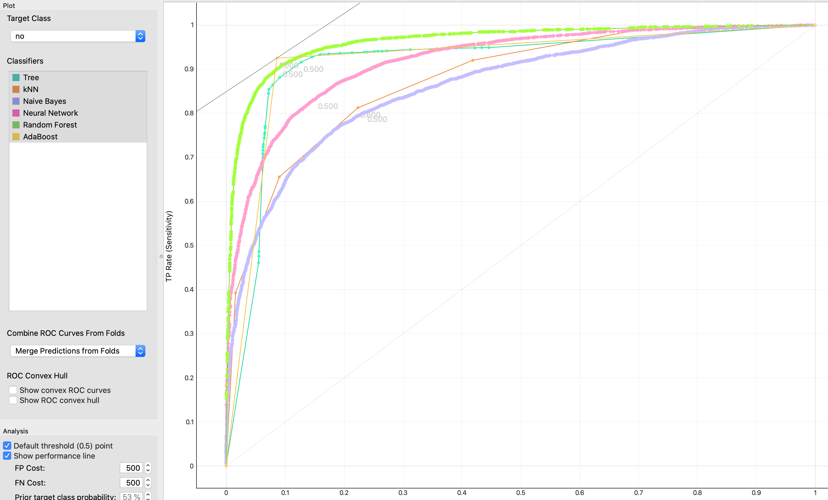
Classification Model
Prediction algorithm used to predict the classification accuracy of opening a term deposit for the test data.
Models Used -Decision Tree, Random Forest, Naïve Bayes, Neural network, Random Forest, AdaBoost
The classification accuracy is highest for AdaBoost followed by Random Forest.
The ROC curve tells us how well our classifier is classifying between term deposit subscriptions (True Positives) and non-term deposit subscriptions.
Y-axis – True Positives Rate
X -axis – False Positives Rate

Slide 18
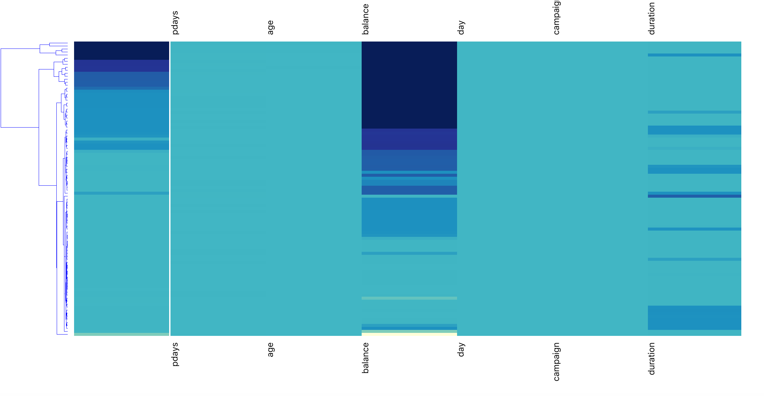

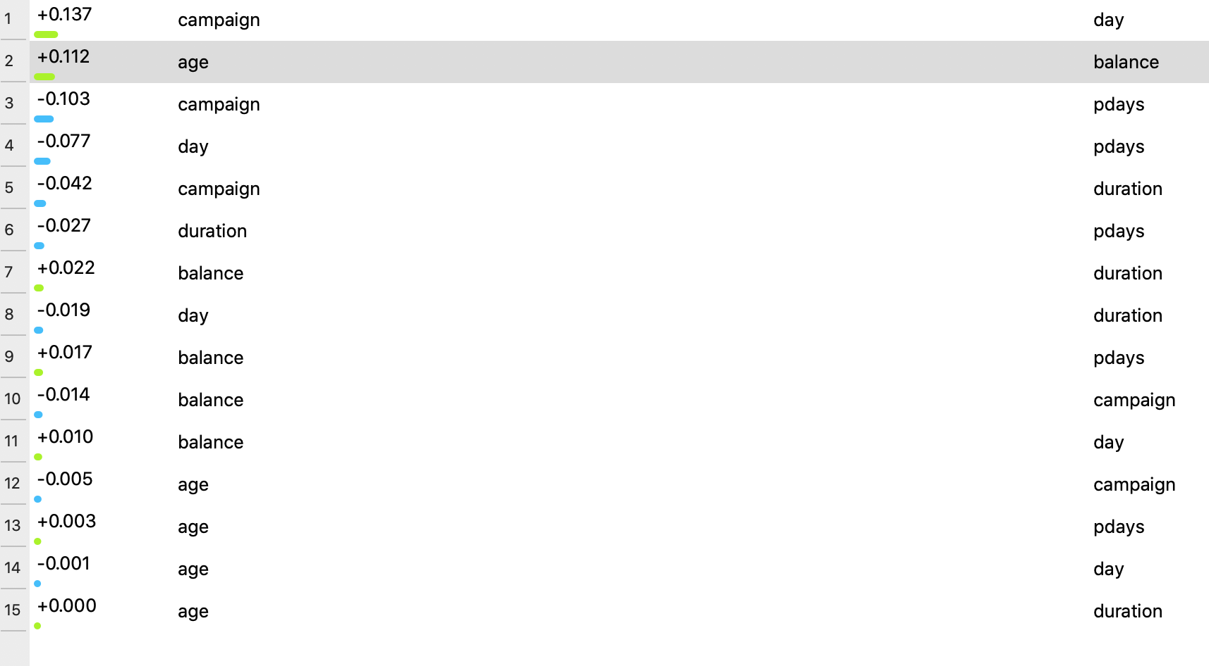
Statistical Analysis
Correlation Matrix –With Orange data mining tool we tried to look into the numeric variables in the dataset that correlate with each other.
Heat Map –Correlation heat map for numerical variables. The values are represented by color: the higher a certain value is, the darker the represented color.

Slide 19
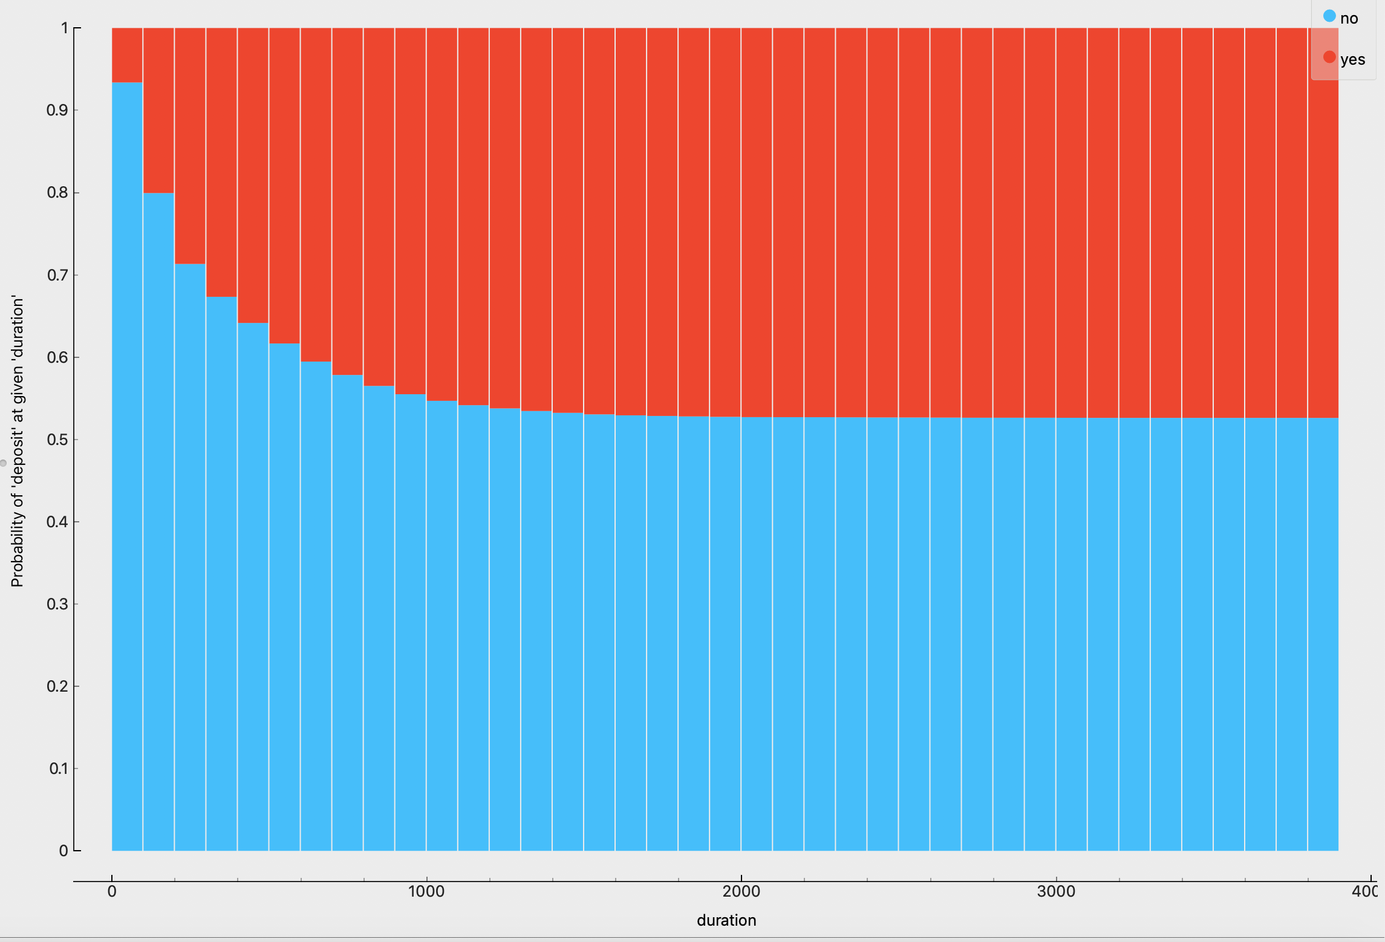
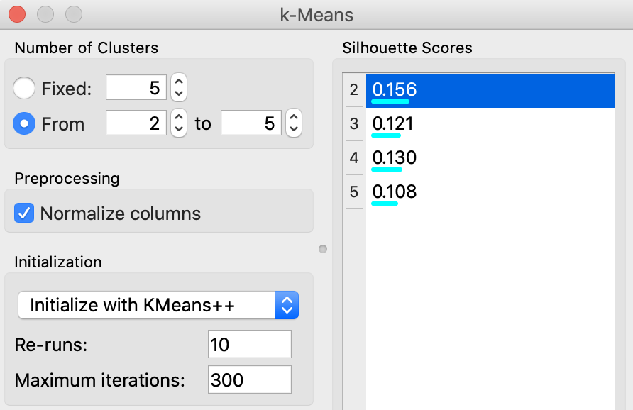
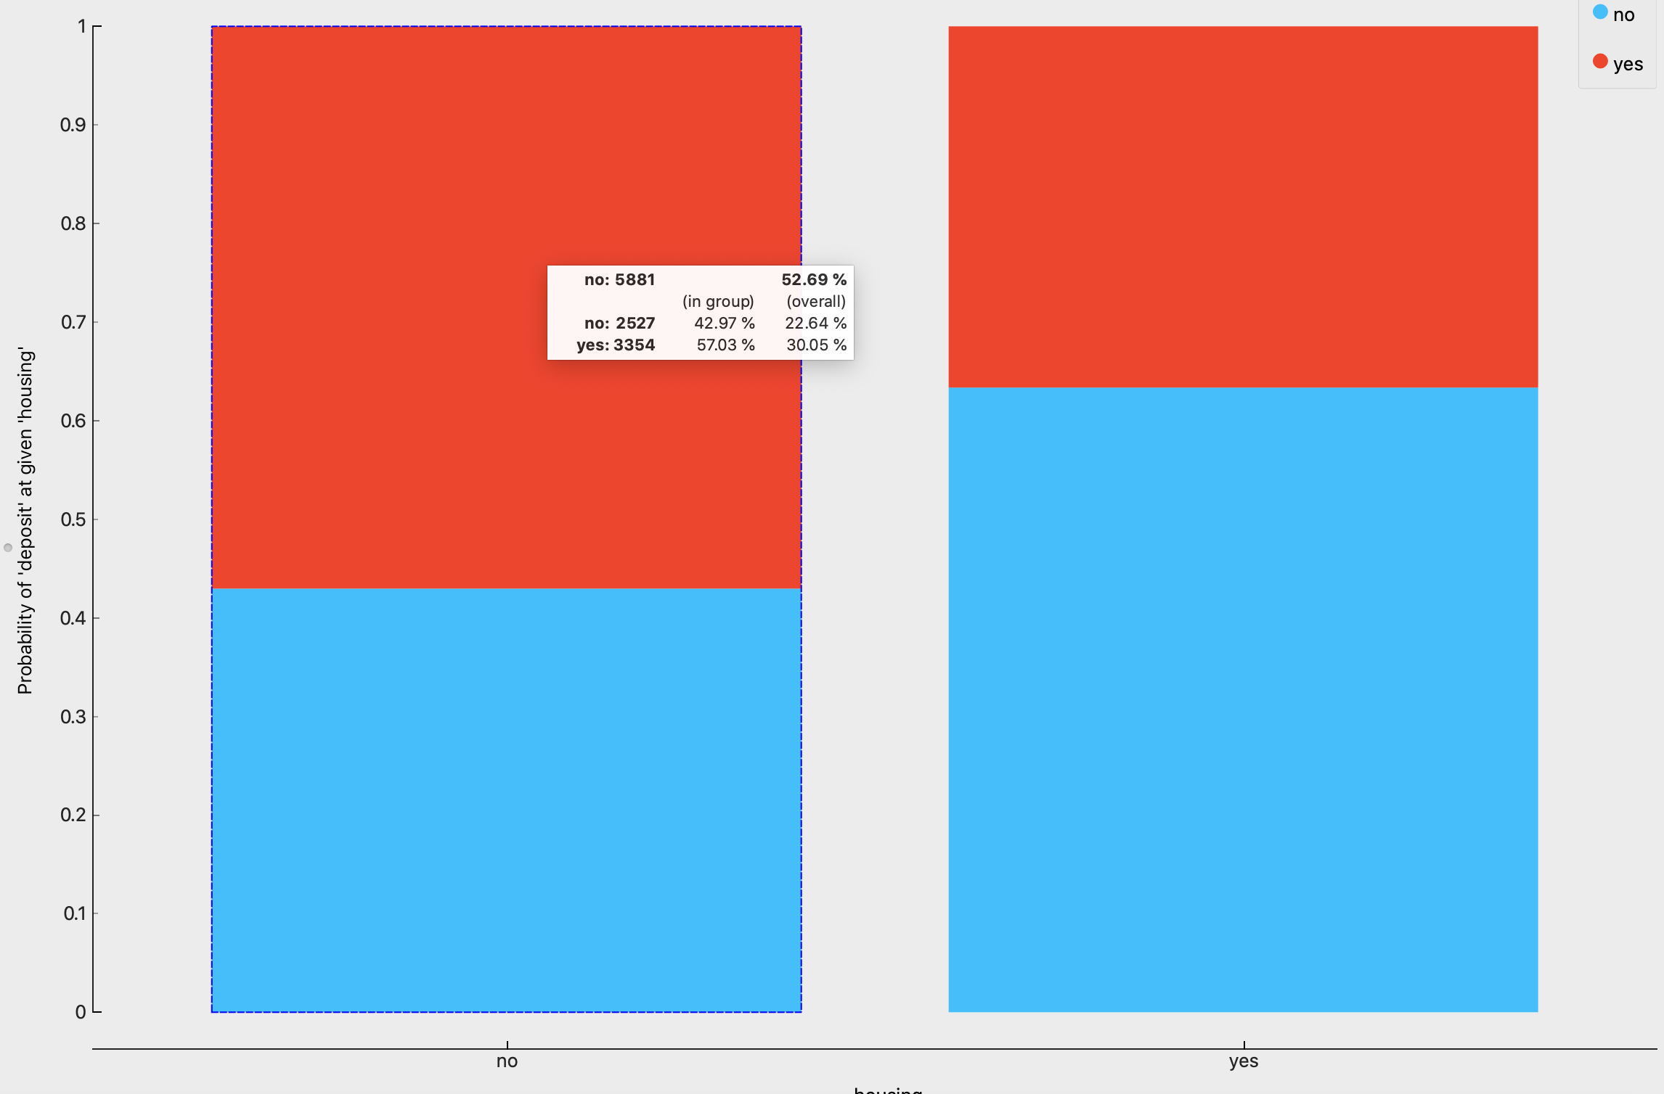
Statistical Analysis
K-Means Clustering – To group data in clusters. Selected the value of K to determine the number of cluster. Here K=5
The chart represents that the probability of opening a term deposit is more in a cluster where there is no housing loan. This means that the potential client has financial compromises to pay back its house loan and thus, there is no cash for he or she to subscribe to a term deposit account.
Target individuals with a higher duration above average- there is a highly likelihood that this target group would open a term deposit account.

Slide 20
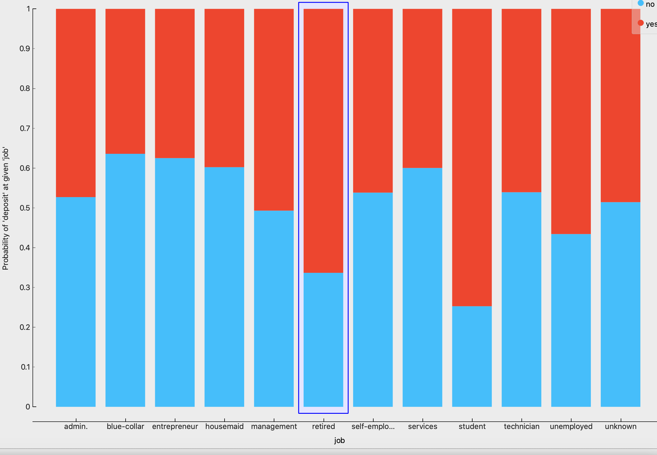
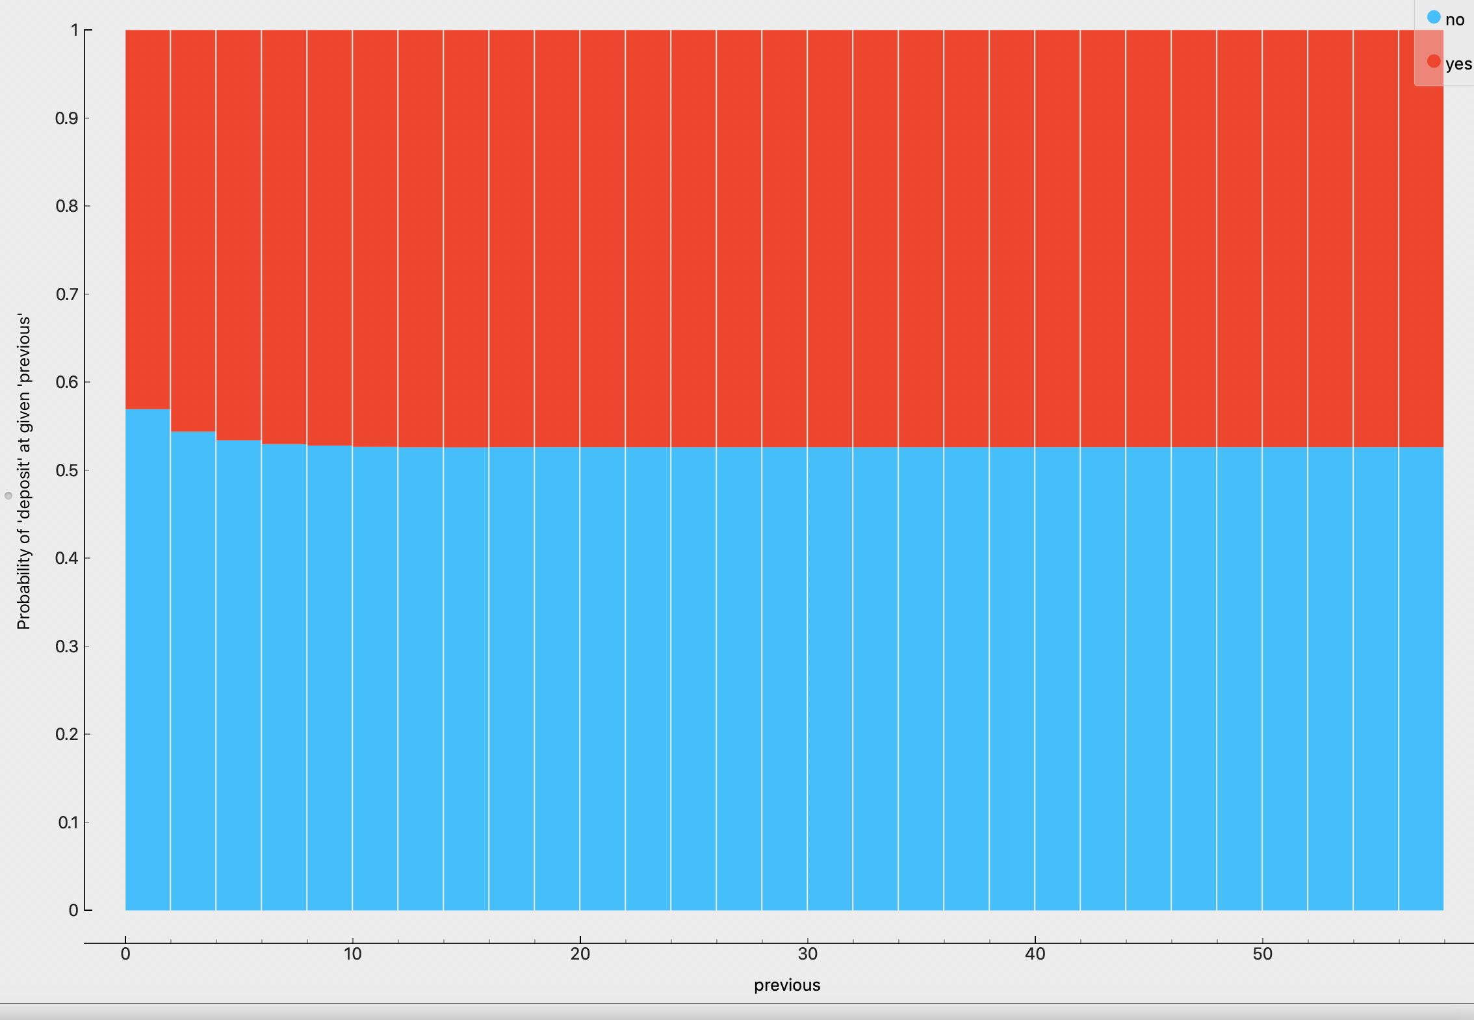
Statistical Analysis
Potential clients that were students or retired were the most likely to subscribe to a term deposit. Retired individuals tend to not spend big and are more likely to put their cash to work by lending it to the financial institution.
More the number of contacts made with any customer resulted in probability of increase in opening a term deposit.

Slide 21
Recommendations
The marketing activities should be increased in the month of March, September, October and December, as we have highest percentage of individuals subscribing to term deposit in those month
A policy should be implemented that states that no more than 3 calls should be applied to the same potential client in order to save time and effort in getting new potential clients. As data suggest, the more we call the same potential client, the likely he or she will decline to open a term deposit
Occupation: Not surprisingly, potential clients that were students or retired were the most likely to subscribe to a term deposit. But About 60% of the job roles in the dataset belonged to just three categories, namely admin, blue collar and are subscribing to term deposit. Hence next campaign should consider high percentage subscriber job role as well as the roles highest contributor. The next campaign should take into account both the categories mentioned above to increase the likelihood of increasing the subscription.

Slide 22
Recommendations
House Loans and Balances : the next marketing campaign should focus on individuals of average and high balances in order to increase the likelihood of subscribing to a term deposit
Target individuals with a higher duration (above 375): Target the group that is above average in duration, there is a highly likelihood that this target group would open a term deposit account.
Develop a Questionnaire : Since duration of the call is the feature that most positively correlates with whether a potential client will open a term deposit or not, by providing an interesting questionnaire for potential clients during the calls the conversation length might increase

Slide 23
Thank you!

